Slide 1

Working with Assistants Part 9: Still Working with Runs

Slide 2
What’s Covered in This Session
Token Management
JSON Output
Listing Runs
Retrieving Runs
Creating a Thread and Run Dynamically
Modifying Runs
Cancelling Runs

Slide 3
Token Management
Tokens are critical to success
Notes:
https://platform.openai.com/docs/api-reference/runs/createRun

Slide 4
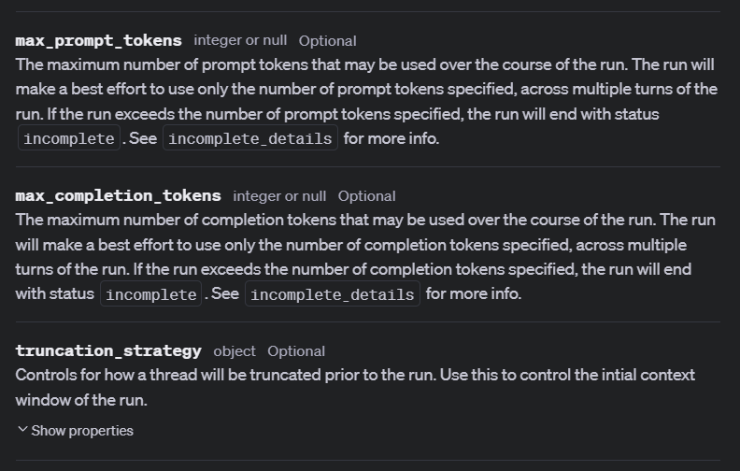

Slide 5
Demo: Token Management (max_prompt_tokens)
# Now let's do a run limiting the prompt tokens
with client.beta.threads.runs.stream(
thread_id=thread.id,
assistant_id=assistant.id,
# max_prompt_tokens=5, # must be set to 256 or more
max_prompt_tokens=256,
event_handler=EventHandler(),
) as stream:
stream.until_done()

Slide 6
Other Settings
Misc Arguments
Notes:
https://platform.openai.com/docs/api-reference/runs/createRun

Slide 7
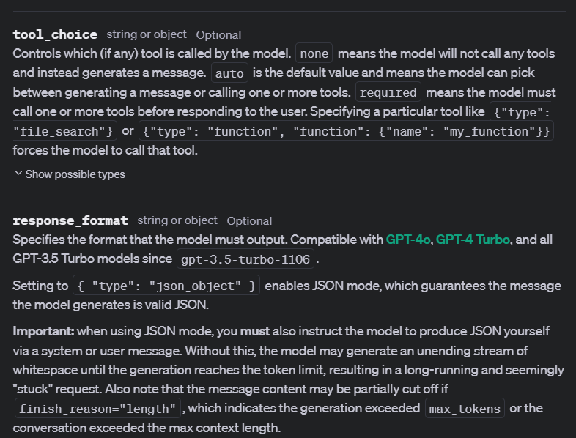

Slide 8
Demo: Other Settings
with client.beta.threads.runs.stream(
thread_id=thread.id,
assistant_id=assistant.id,
additional_instructions="Make sure your output is in JSON format.",
response_format={"type" : "json_object"},
tool_choice=None,
event_handler=EventHandler(),
) as stream:
stream.until_done()

Slide 9



Notes:
https://www.youtube.com/channel/UC35ZpwldGw7ZJ5R-2sLijzw

Slide 10

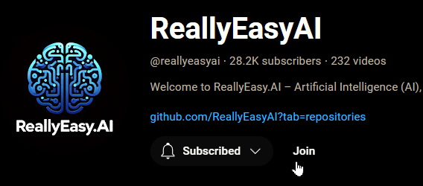
Membership has its privileges
Notes:
https://www.youtube.com/channel/UC35ZpwldGw7ZJ5R-2sLijzw/join

Slide 11
Listing Runs
Well, listing them again, anyway ☺
Notes:
https://platform.openai.com/docs/api-reference/runs/listRuns

Slide 12
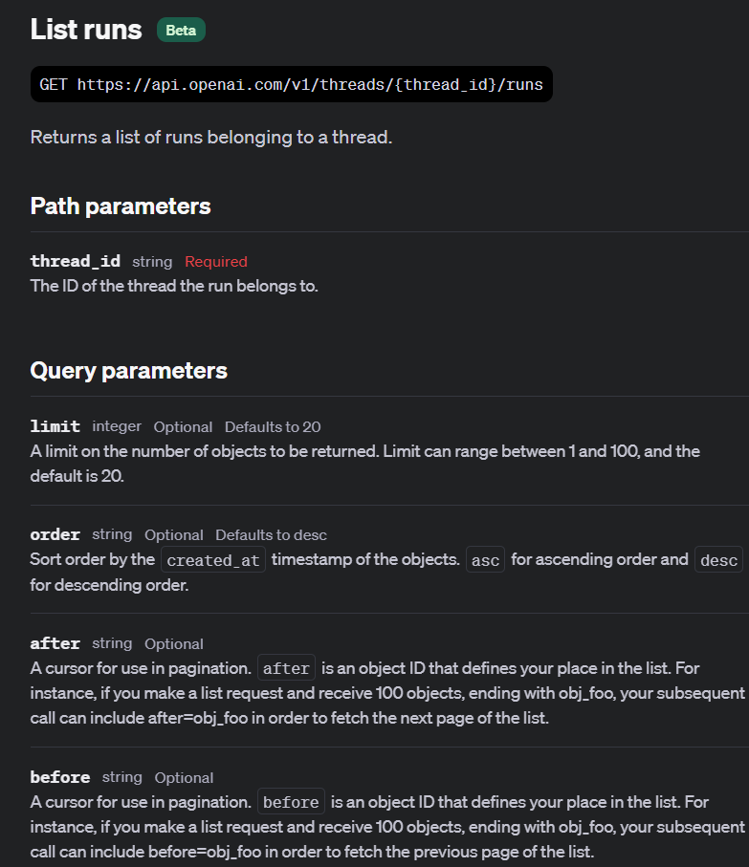

Slide 13
Demo: Listing Runs
# Let's list our runs to see what we have
runs = client.beta.threads.runs.list(
thread_id=thread.id,
order="desc",
)

Slide 14
Retrieving Runs
Review How to Get Runs Back
Notes:
https://platform.openai.com/docs/api-reference/runs/getRun

Slide 15
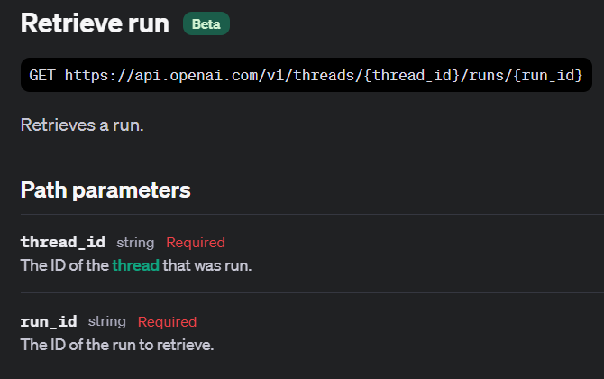

Slide 16
Demo: Retrieve Run
run = client.beta.threads.runs.retrieve(
thread_id=thread.id,
run_id=runs_list[0].id
)

Slide 17
Create Thread and Run
Helper Functions FTW!
Notes:
https://platform.openai.com/docs/api-reference/runs/createThreadAndRun

Slide 18
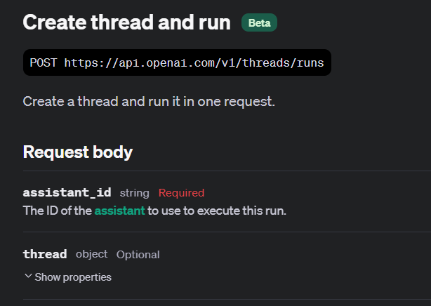

Slide 19
Demo: Create Thread and Run
run = client.beta.threads.create_and_run(
assistant_id=assistant.id,
thread={
"messages": [
{"role": "user", "content": "Explain deep learning to me like I'm a 5 year old."}
]
}
)

Slide 20
Modifying Runs
Change that Metadata
Notes:
https://platform.openai.com/docs/api-reference/runs/modifyRun

Slide 21
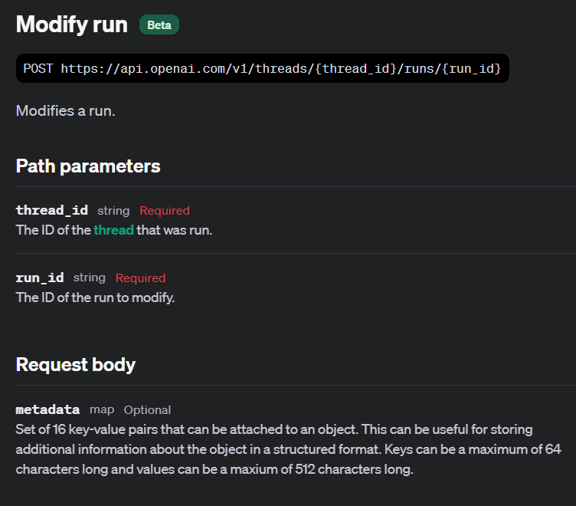

Slide 22
Demo: Modifying a Run
run = client.beta.threads.runs.update(
thread_id=run.thread_id,
run_id=run.id,
metadata={"user_id": "user_abc123"},
)

Slide 23
Canceling Runs
Stop the Run in Progress
Notes:
https://platform.openai.com/docs/api-reference/runs/cancelRun

Slide 24
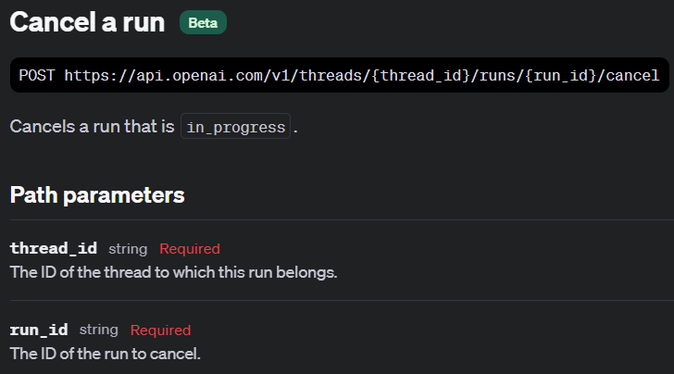

Slide 25
Demo: Cancelling a Run
for event in stream_run:
if hasattr(event.data, 'status'): # Check if 'status' is an attribute of the event data
print(event.data.id)
print(event.data.status)
if event.data.status == "in_progress":
print("Cancelling the run.")
cancelled_run = client.beta.threads.runs.cancel(thread_id=thread.id, run_id=event.data.id)
else:
print(f"Event ID: {event.data.id} does not have a status attribute.")
print(event.data.delta)
print("---------------\n")

Slide 26


